Slide 1

DIGITAL ENCYCLOPEDIA
With Weather Online
Herry Nurmawanto Atwar
Inodesain Jayautama Mandiri

Slide 2
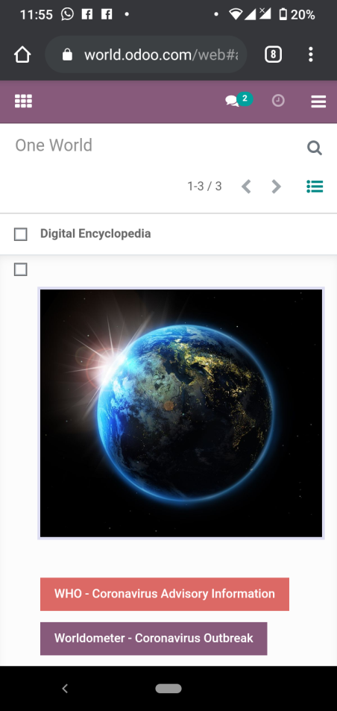
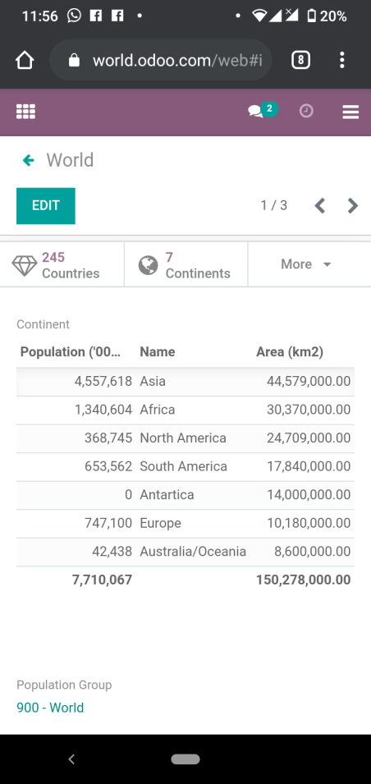
World.odoo.com
DIGITAL
Encyclopedia
One World
Continent

Slide 3
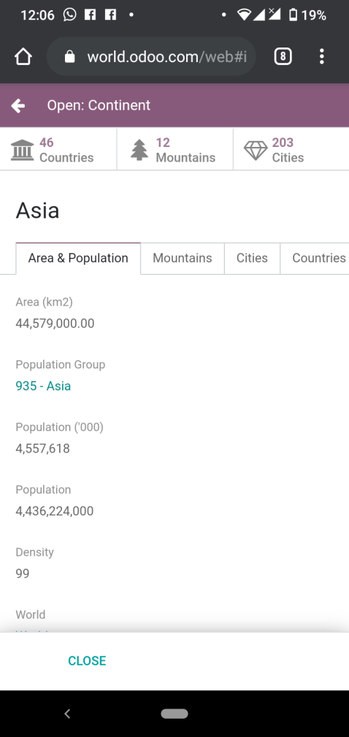
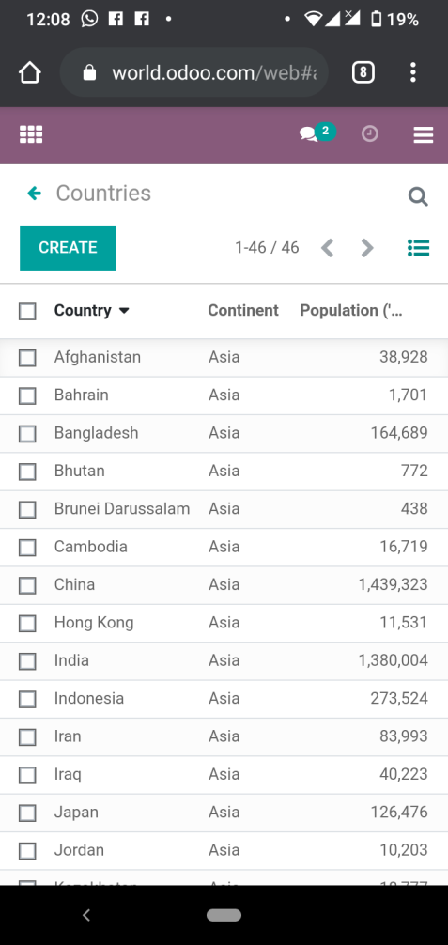
asia
Area
Population
Density
Countries

Slide 4
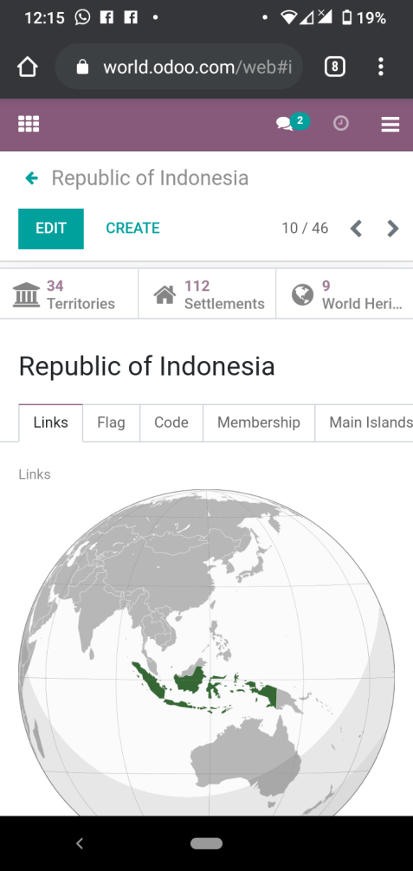
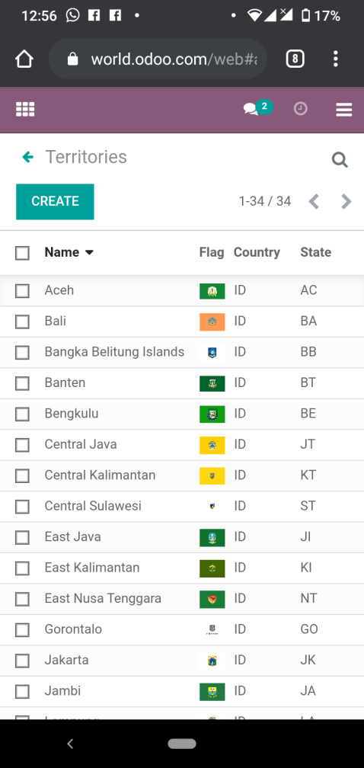
indonesia
Links
Flag
State Code
Territories

Slide 5
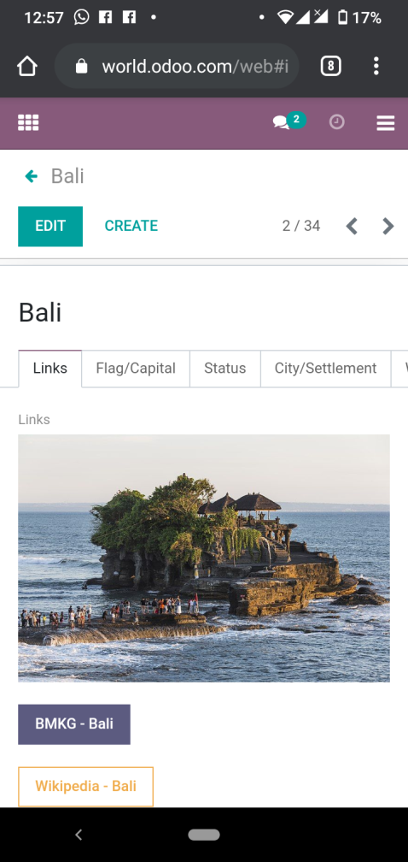
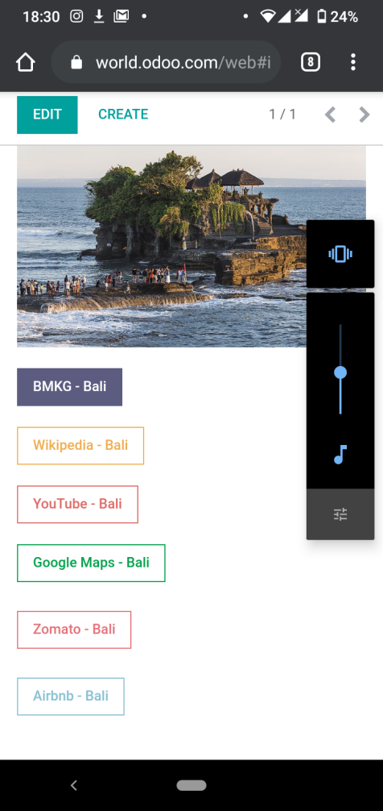
bali
Links
BMKG
Wikipedia
YouTube
Google Maps
Zomato
Airbnb

Slide 6
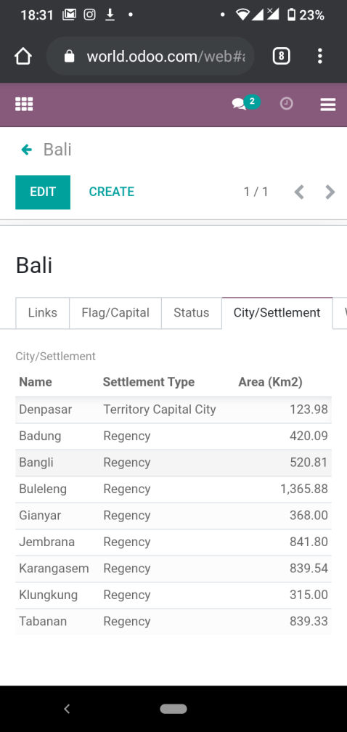
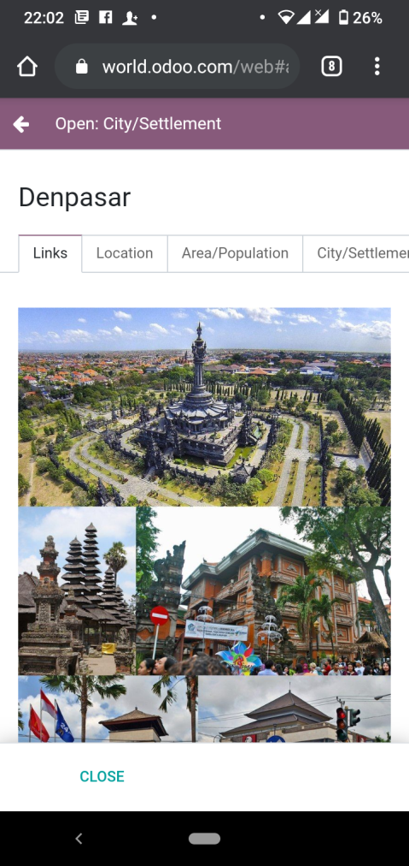
City/settlement
Links
BMKG
Wikipedia
YouTube
Google Maps
Zomato
Airbnb
Denpasar

Slide 7
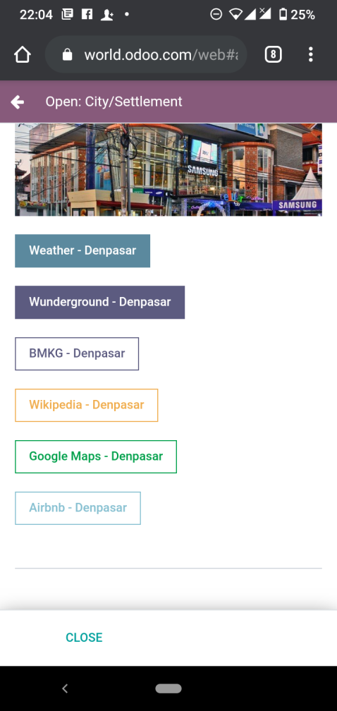
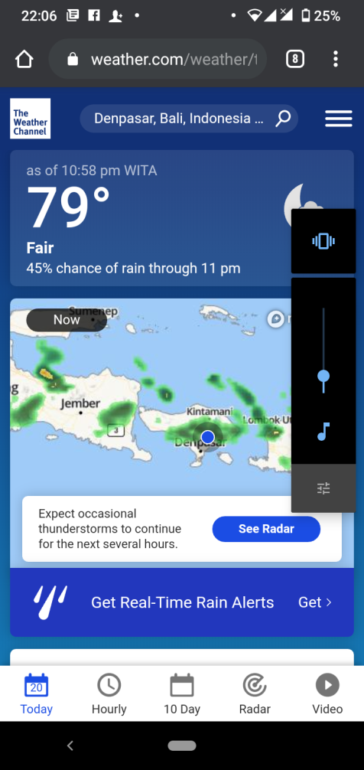
denpasar
Links
Weather
Wunderground
BMKG
Wikipedia
Google Maps
Airbnb
Weather

Slide 8
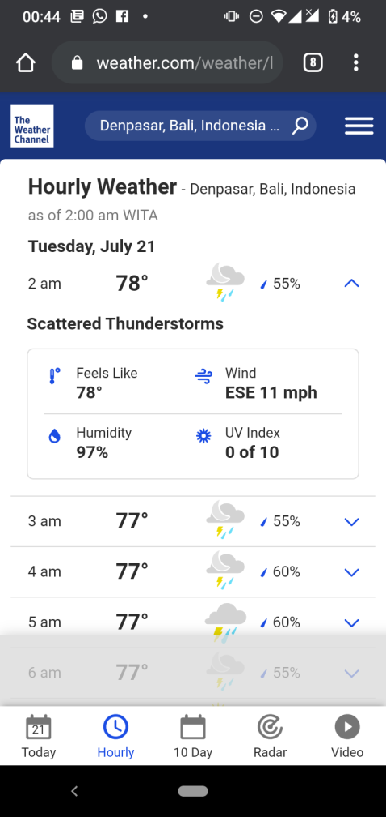
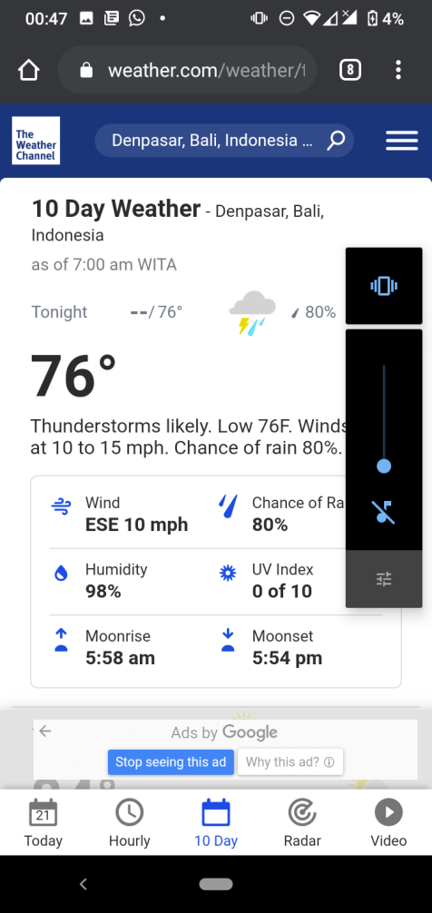
denpasar
Hourly Weather
Temperature
Humidity
Wind
UV Index
10 Day Weather
Temperature
Wind
Chance of Rain
Humidity
UV Index
Moonrise
Moonset

Slide 9
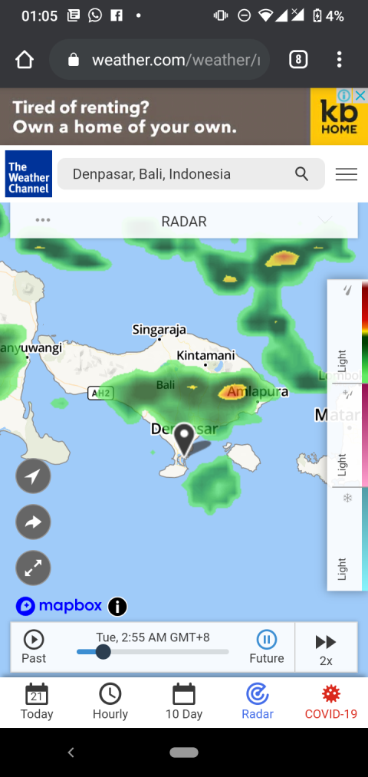
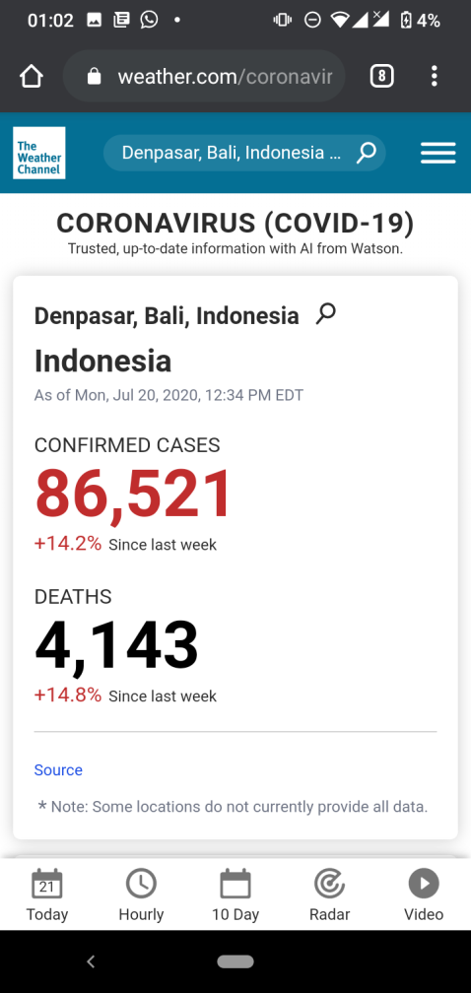
denpasar
Radar
Weather Online
COVID-19
Indonesia
Confirmed Cases
Deaths

Slide 10
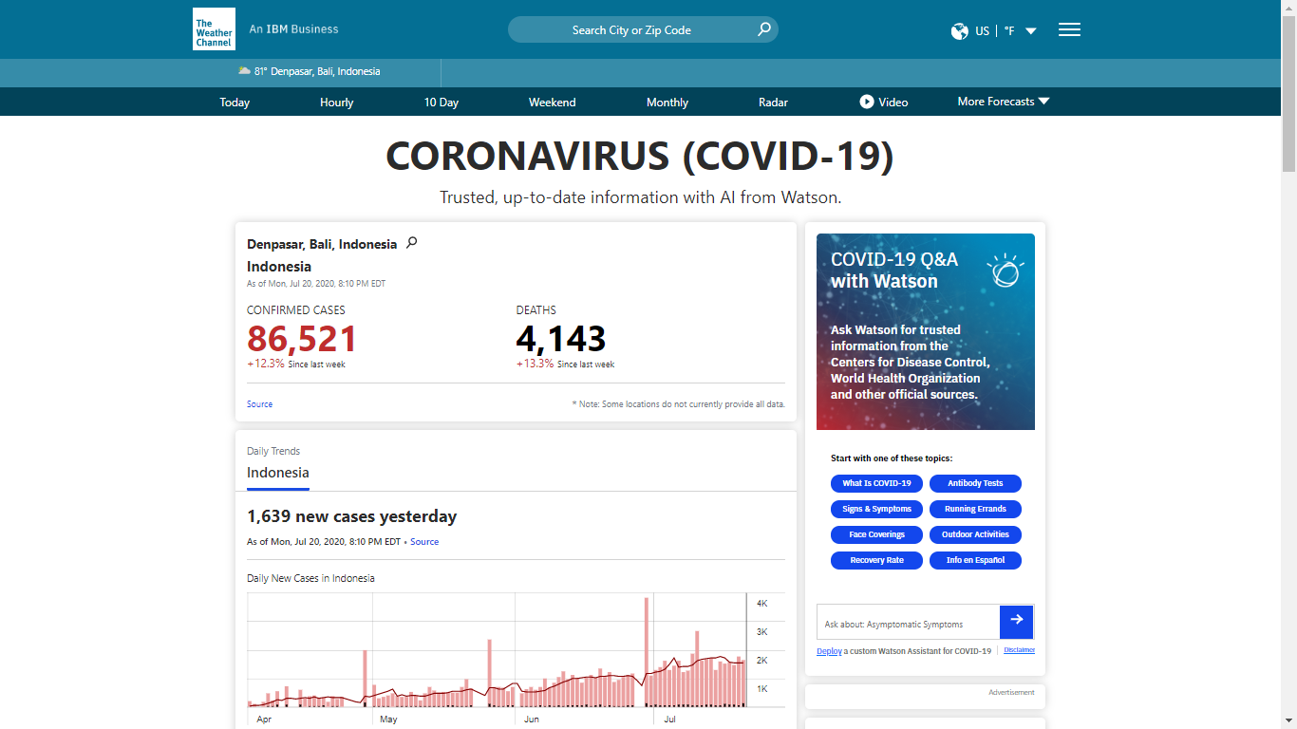
Covid-19

Slide 11
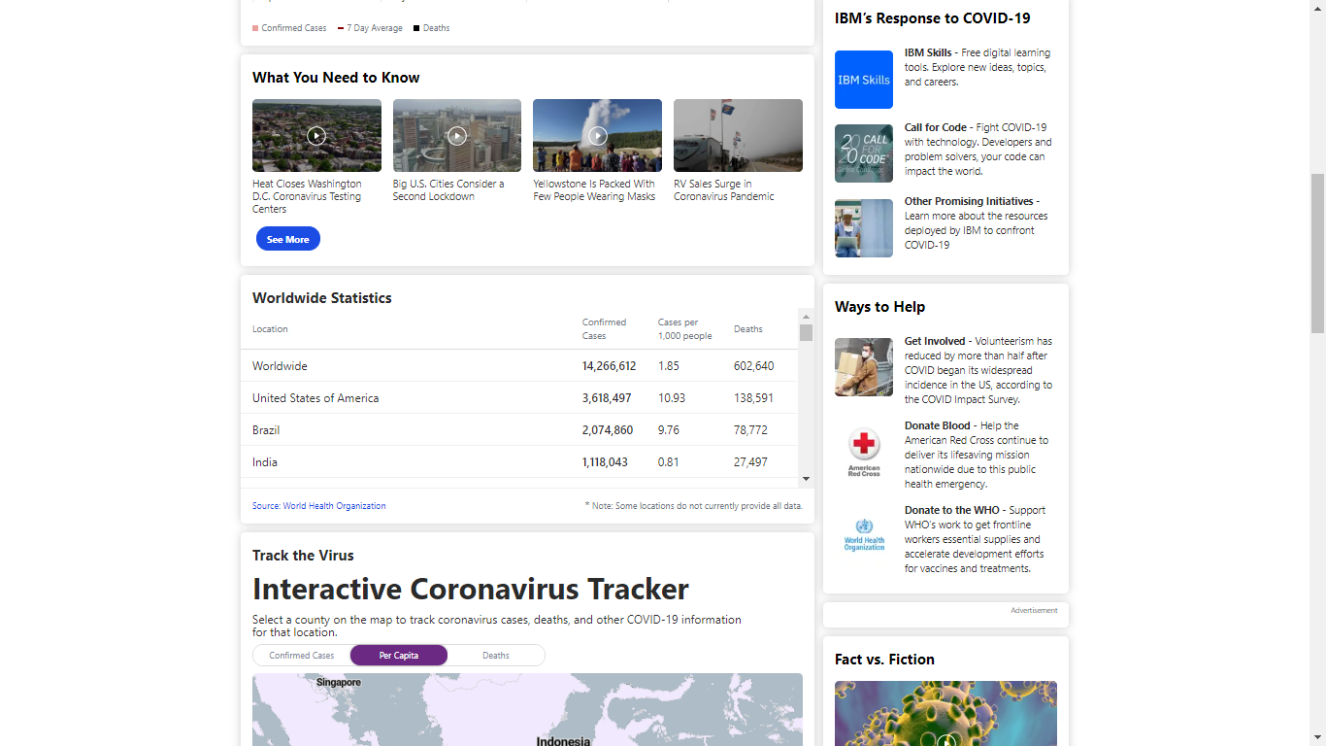
Covid-19

Slide 12
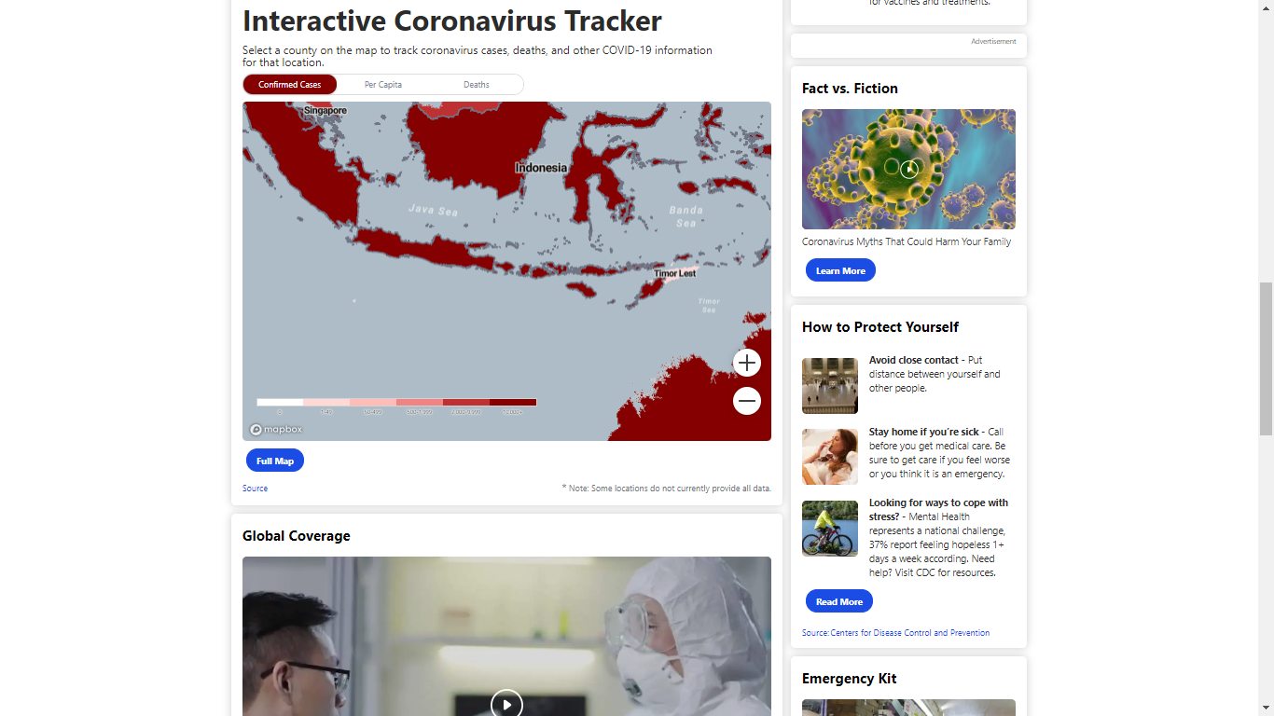
Covid-19

Slide 13
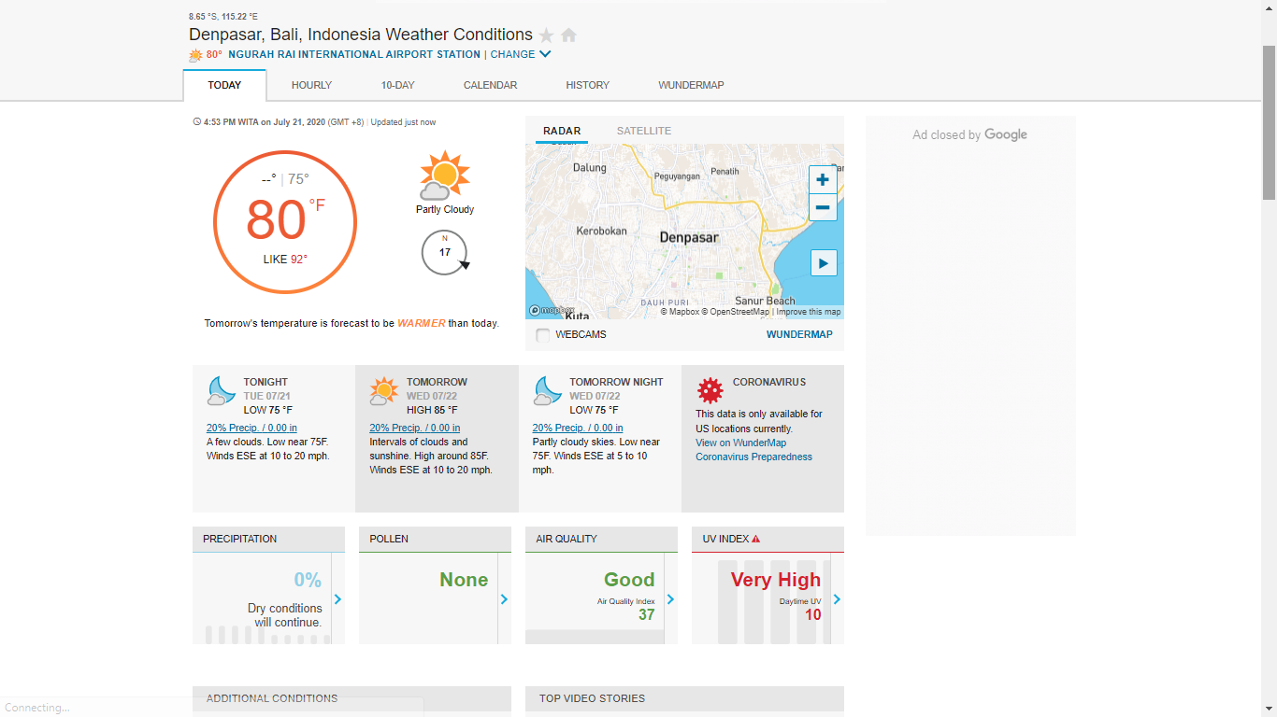
Wunderground

Slide 14
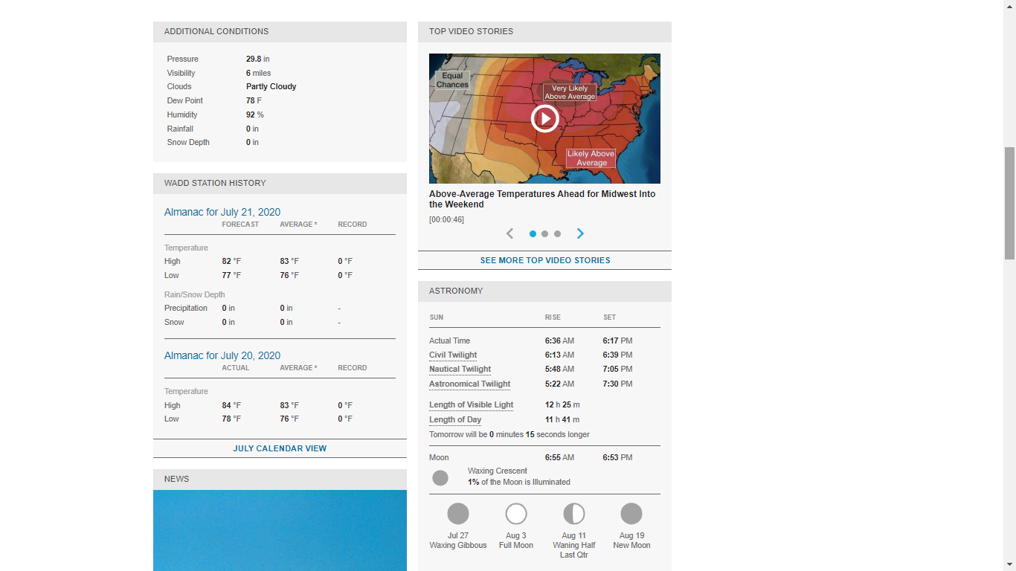
Wunderground

Slide 15
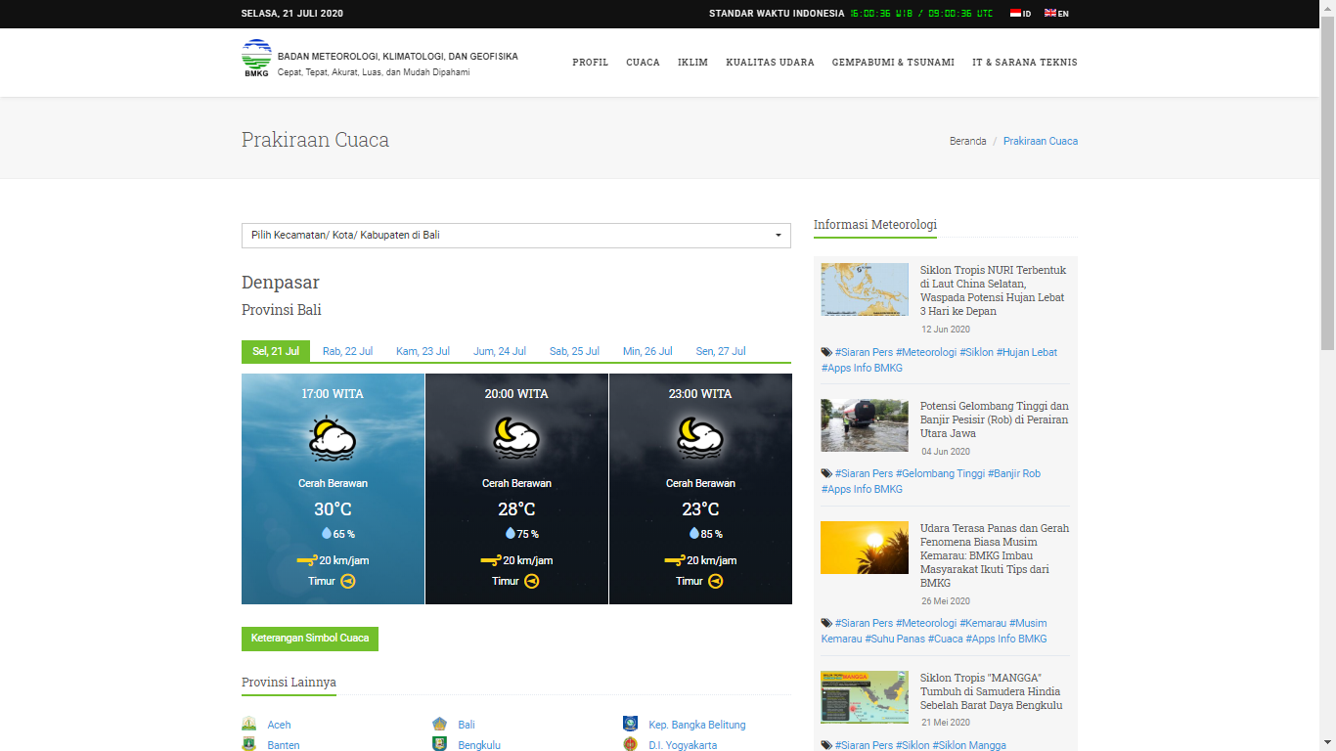
BMKG

Slide 16
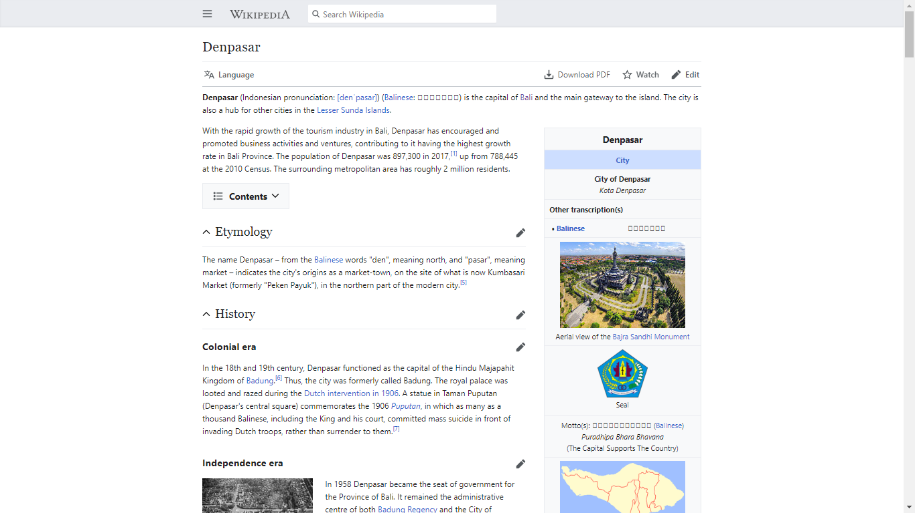
wikipedia

Slide 17
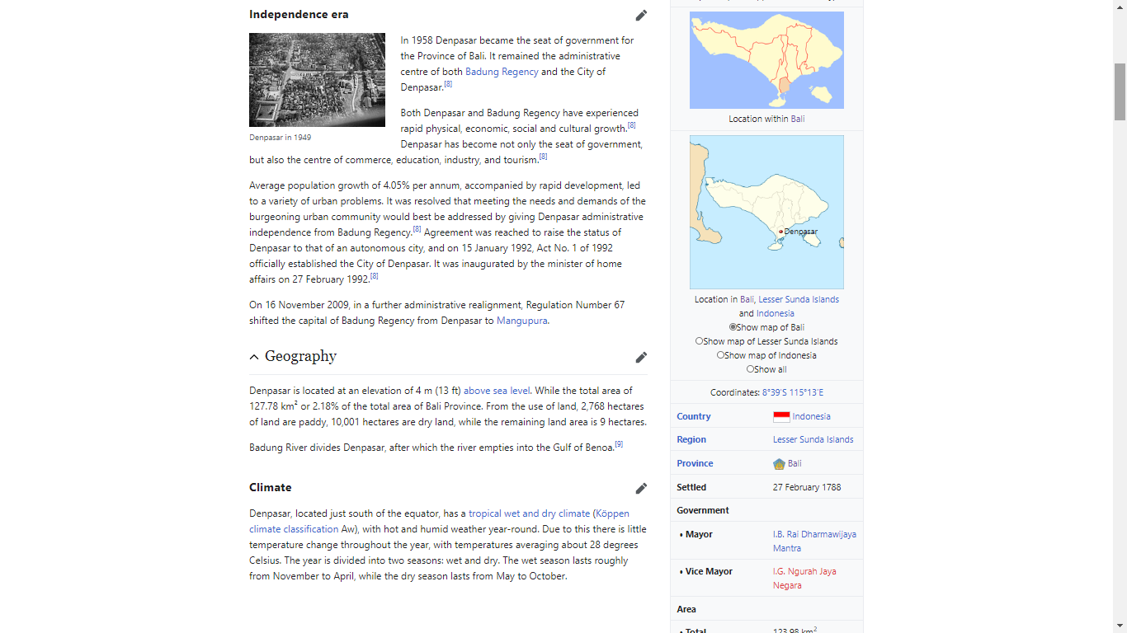
wikipedia

Slide 18
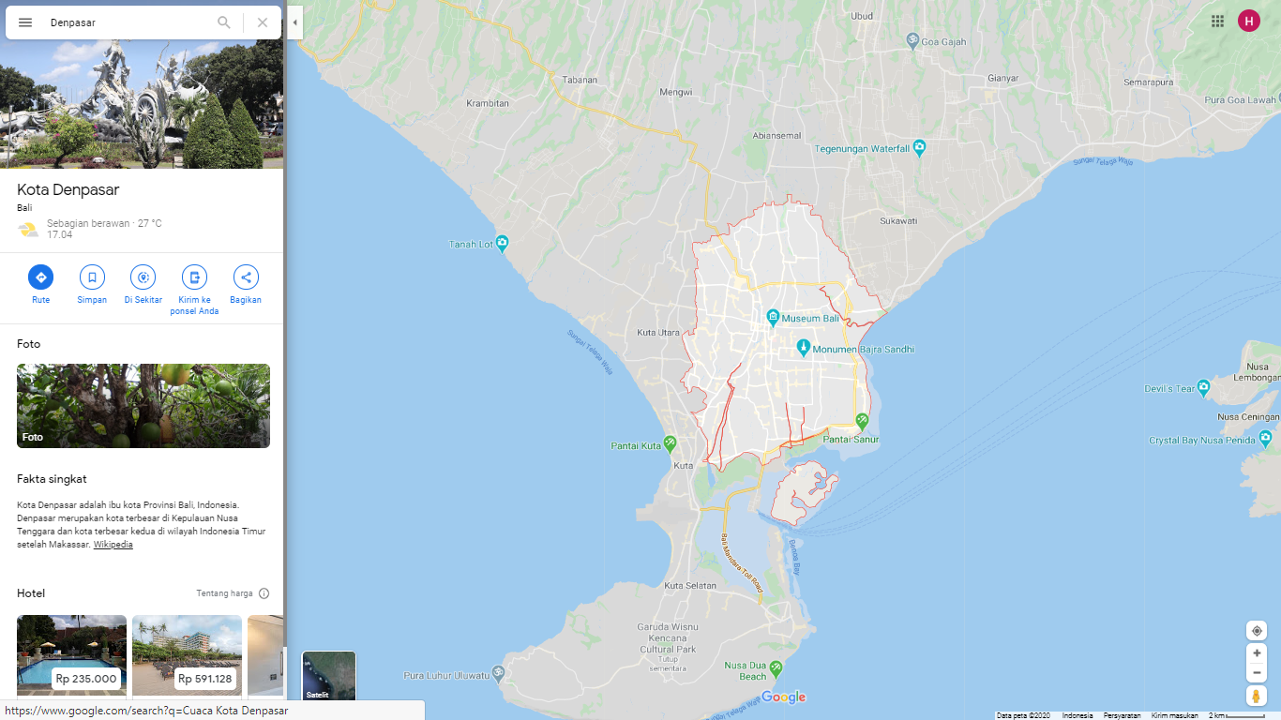
Google maps

Slide 19
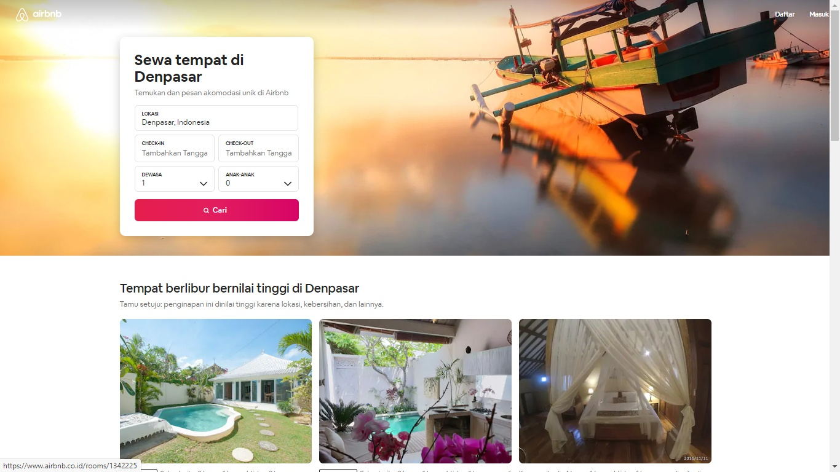
airbnb

Slide 20
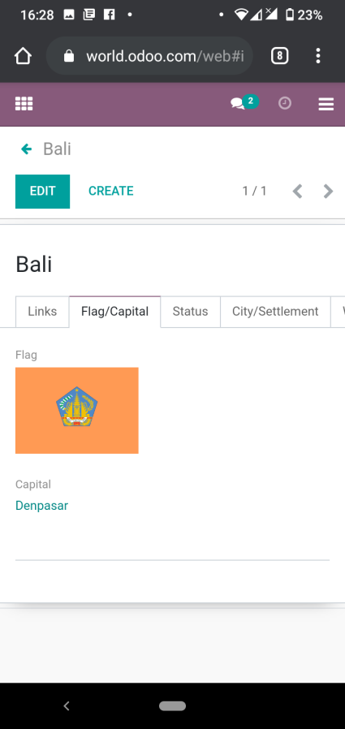
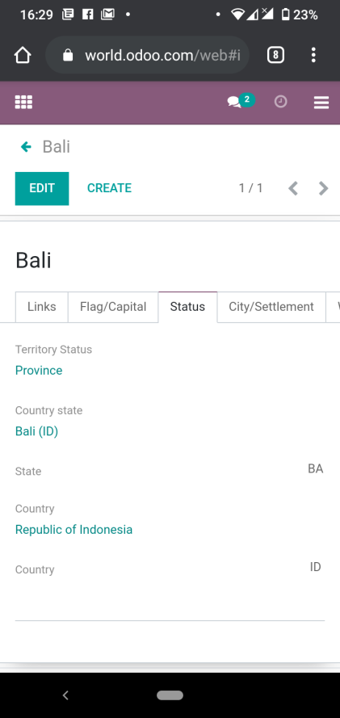
Flag/capital & status
Flag
Capital
Status
Code

Slide 21
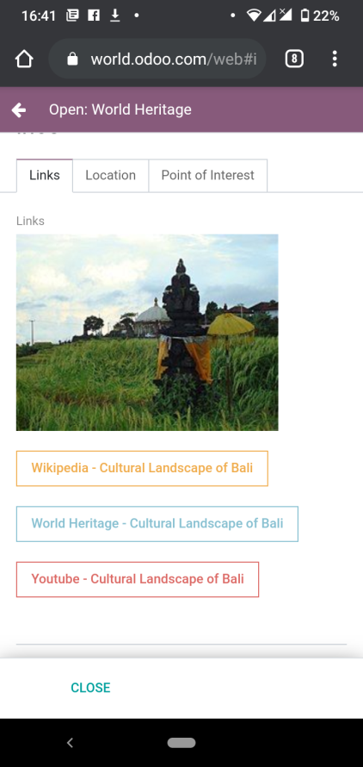
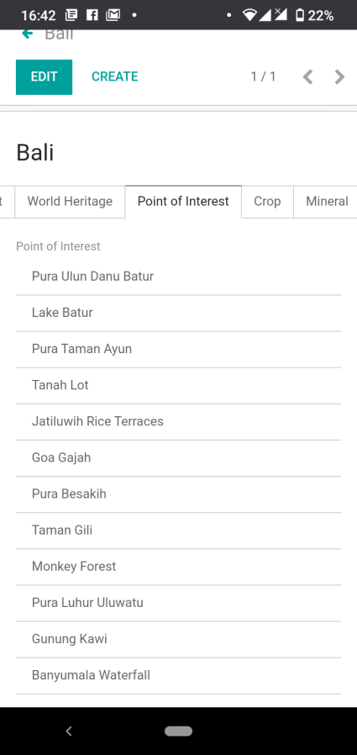
Point of interest
World Heritage
Point of Interest

Slide 22
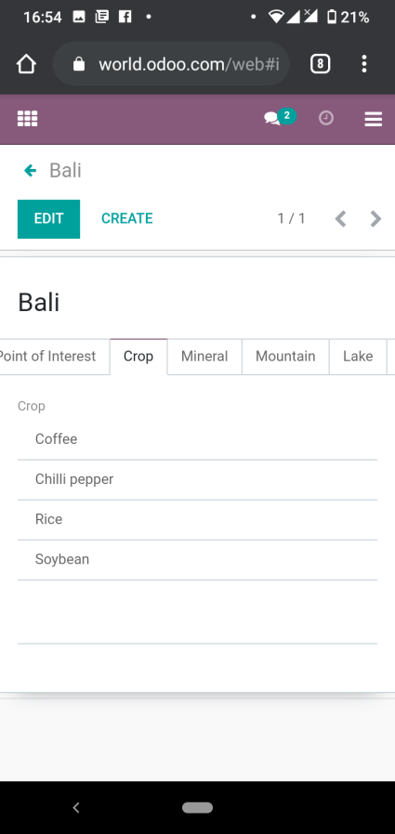
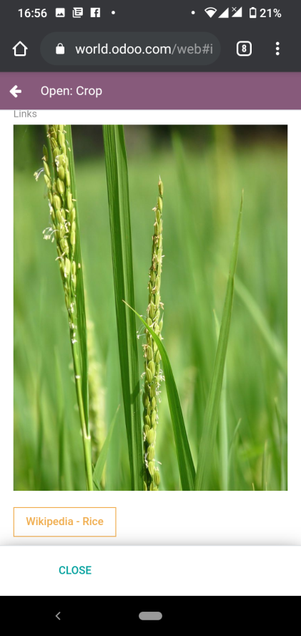
crop
Crop
Picture
Link

Slide 23

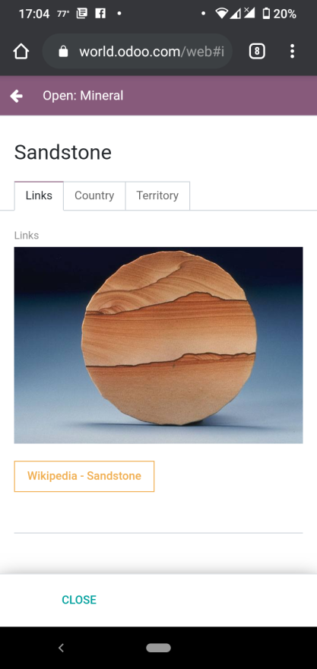
mineral
Mineral
Picture
Link

Slide 24
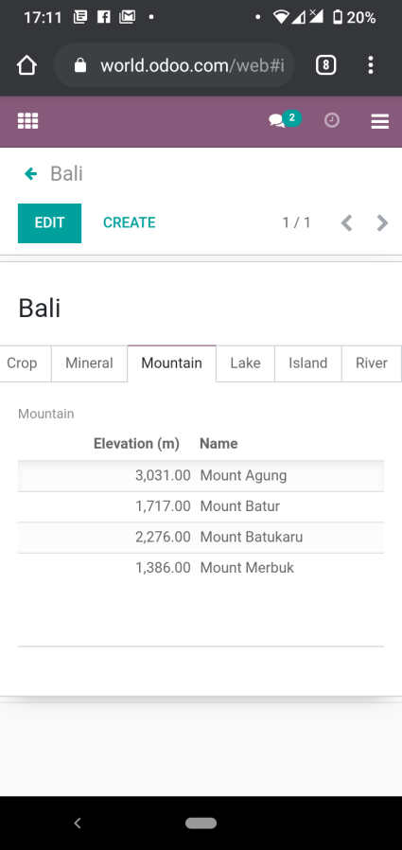
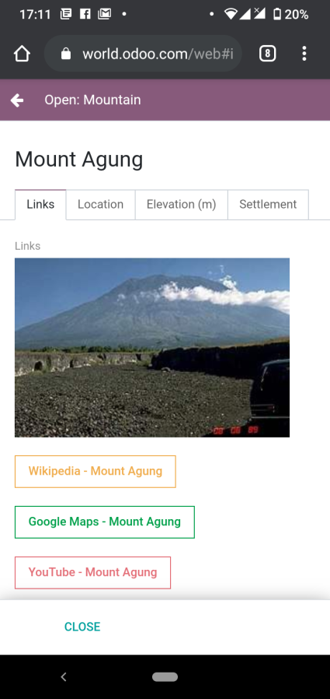
mountain
Mountain
Picture
Link

Slide 25
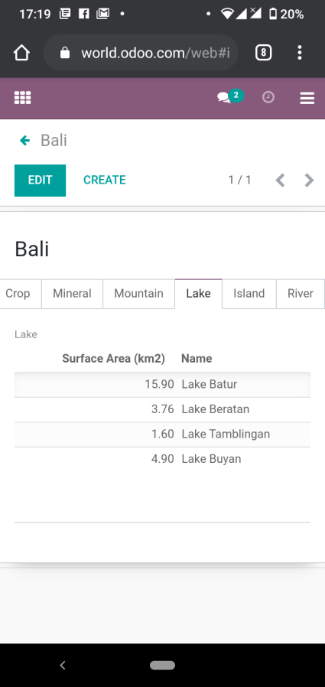
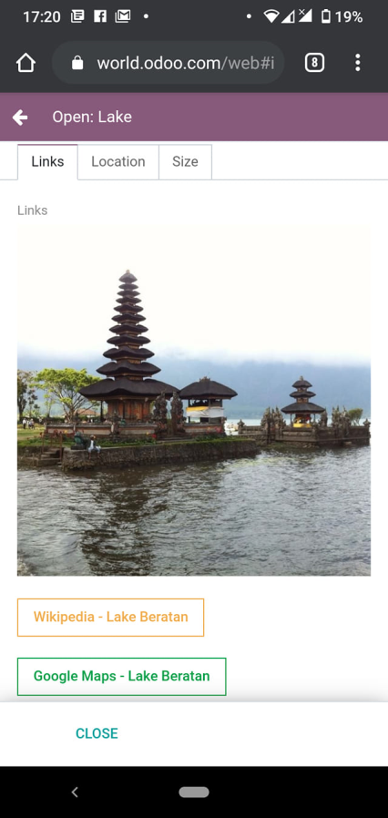
lake
Lake
Picture
Link

Slide 26
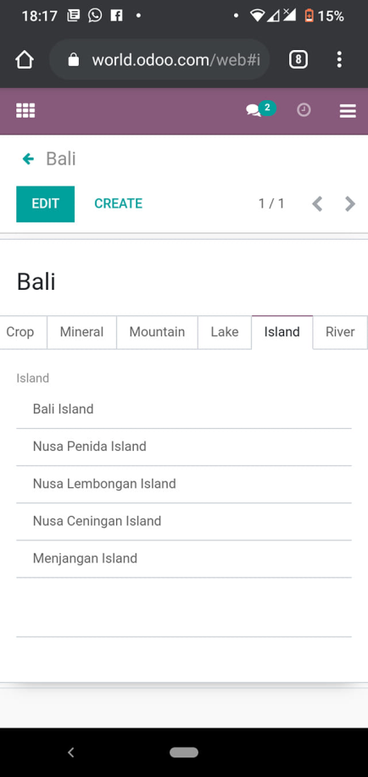
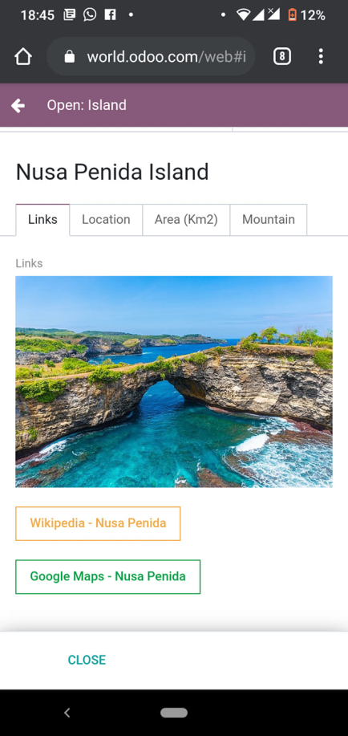
island
Island
Picture
Link

Slide 27
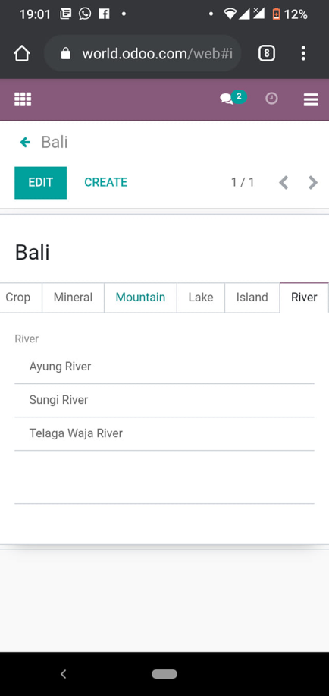
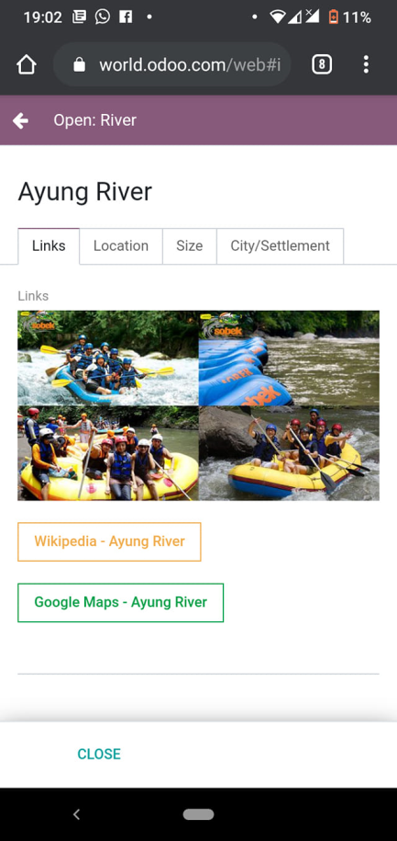
river
River
Picture
Link

Slide 28
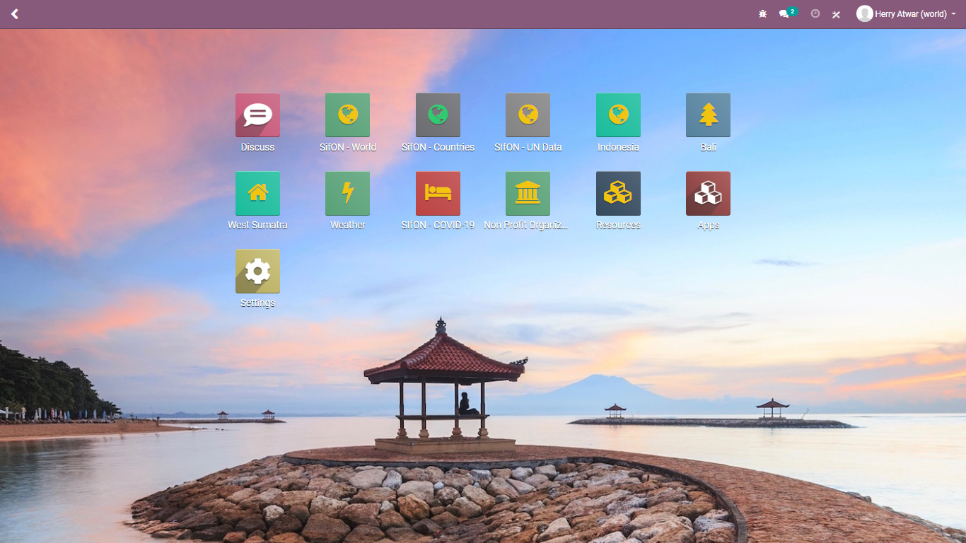
thank you

